Slide 1
BATHOLITHIC ROCKS
210-150mya (Triassic to Jurassic)
120-100mya (Cretaceous)
Western Intrusive Suite (El Capitan Granite)
Minor Intrusive Suite (“Map of N. America”)
95-80mya (Cretaceous)
Tuolumne Intrusive Suite (Half Dome)
A “nested” pluton
Inside – felsic and porphyritic
Outside – mafic and equigranular
Notes:
The batholithic rocks that formed beneath the volcanic arcs have ages that cluster into three distinct groups. The oldest group is about 210 to 150 million years old, or late Triassic to Jurassic.

Slide 2
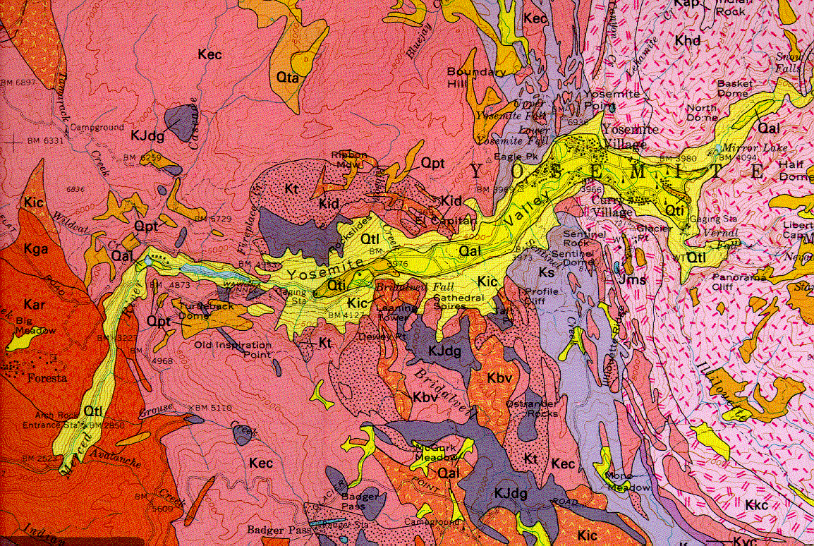
Oldest plutonic rocks
Notes:
These oldest of the batholithic rocks are shown in purple here and tend to be mostly diorite and gabbro.

Slide 3
Younger plutonic rocks
Notes:
They are intruded by the younger and generally more felsic plutonic rocks shown in the darker pink here…

Slide 4
BATHOLITHIC ROCKS
210-150mya (Triassic to Jurassic)
120-100mya (Cretaceous)
Western Intrusive Suite (El Capitan Granite)
Minor Intrusive Suite (“Map of N. America”)
95-80mya (Cretaceous)
Tuolumne Intrusive Suite (Half Dome)
A “nested” pluton
Inside – felsic and porphyritic
Outside – mafic and equigranular
Notes:
… which belong to the second group of batholithic rocks, mostly represented by the Western Intrusive Suite. At 120 to 100 million years old, the Western Intrusive Suite is Cretaceous in age.

Slide 5
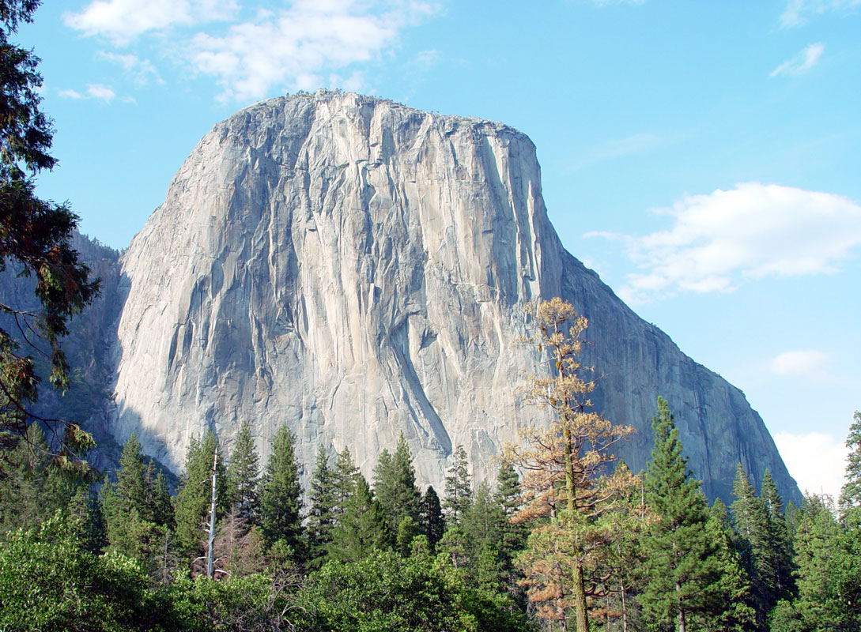
Notes:
The massive granite monolith of El Capitan is representative of the Western Intrusive Suite.

Slide 6
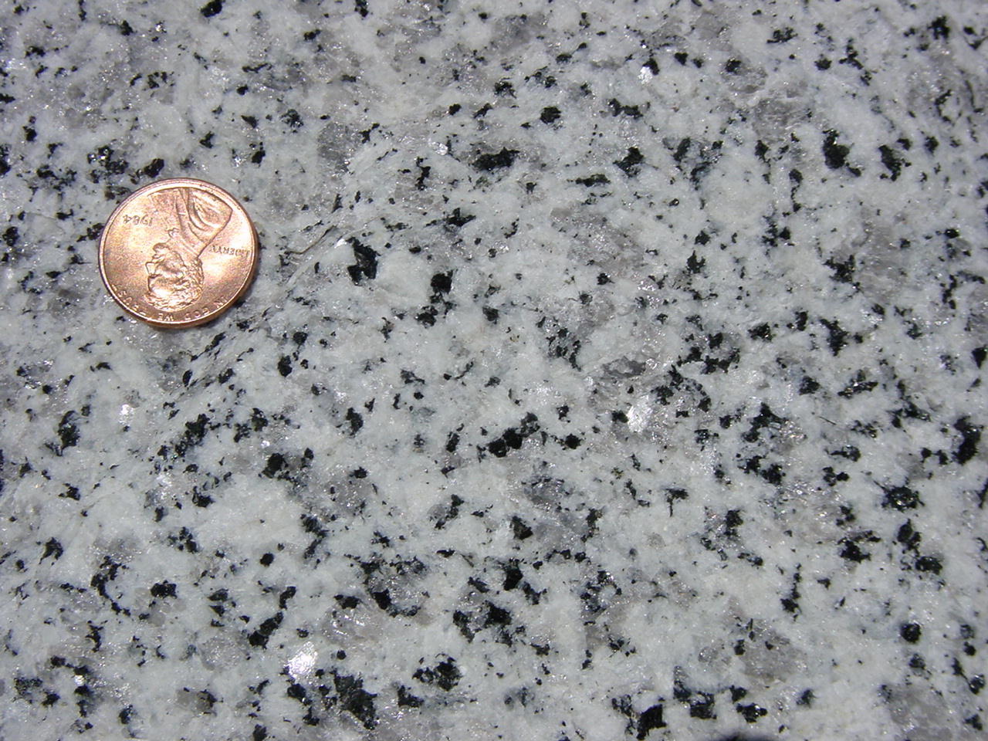
El Capitan Granite
Notes:
The El Capitan Granite is a beautiful rock comprised of slow-cooled, clearly visible crystals.

Slide 7
El Capitan Granite
quartz
Notes:
Typical of granitic rocks, it contains few dark minerals and is mostly quartz (gray glassy looking grains), ….

Slide 8
El Capitan Granite
alkali feldspar
Notes:
… and alkali feldspar (white grains).

Slide 9
El Capitan Granite
biotite
Notes:
The few ferromagnesian minerals here are mostly biotite mica (black grains).

Slide 10
BATHOLITHIC ROCKS
210-150mya (Triassic to Jurassic)
120-100mya (Cretaceous)
Western Intrusive Suite (El Capitan Granite)
Minor Intrusive Suite (“Map of N. America”)
95-80mya (Cretaceous)
Tuolumne Intrusive Suite (Half Dome)
A “nested” pluton
Inside – felsic and porphyritic
Outside – mafic and equigranular
Notes:
The same period of magmatism also produced a few relatively mafic rocks most notably represented by the so-called “Map of North America”…

Slide 11
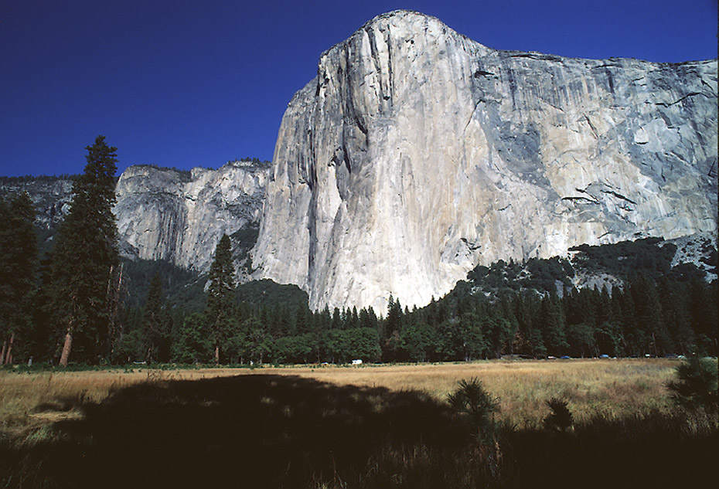
“Map of North America”
Notes:
… which is a diorite intrusion on the east face of El Capitan.

Slide 12
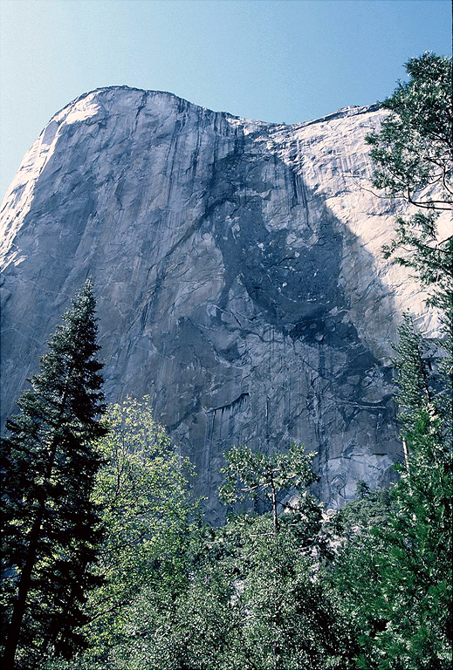
Notes:
Viewed from the right angle and degree of tolerance …

Slide 13
Notes:
… the resemblance, albeit crude, is obvious. Given the position of Baja California, perhaps this is a version of what North America will look like in the geologic future.

Slide 14
Western Intrusive Suite
Farallon Plate
North American Plate
NEVADAN OROGENY
Notes:
The Western and Minor Intrusive Suites were emplaced early in the ocean-continent collision known as the Nevadan Orogeny. Since the accretionary wedge was relatively small and the angle of subduction relatively steep at the time, subduction-generated magmatism occurred fairly close to the trench.

Slide 15
Western Intrusive Suite
North American Plate
Farallon Plate
NEVADAN OROGENY
Notes:
But the accelerating westward motion of the North American plate, combined with a growing accretionary wedge, flattened the subduction angle …

Slide 16
Western Intrusive Suite
Tuolumne Intrusive Suite
North American Plate
NEVADAN OROGENY
Farallon Plate
Notes:
… such that by the late Cretaceous, arc magmatism had shifted eastward and emplaced the “Tuolumne Intrusive Suite”.

Slide 17
BATHOLITHIC ROCKS
210-150mya (Triassic to Jurassic)
120-100mya (Cretaceous)
Western Intrusive Suite (El Capitan Granite)
Minor Intrusive Suite (“Map of N. America”)
95-80mya (Cretaceous)
Tuolumne Intrusive Suite (Half Dome)
A “nested” pluton
Inside – felsic and porphyritic
Outside – mafic and equigranular
Notes:
This suite of plutonic igneous rocks is about 95 to 80 million years old and is geologically well known as the rock of which Half Dome is made.

Slide 18
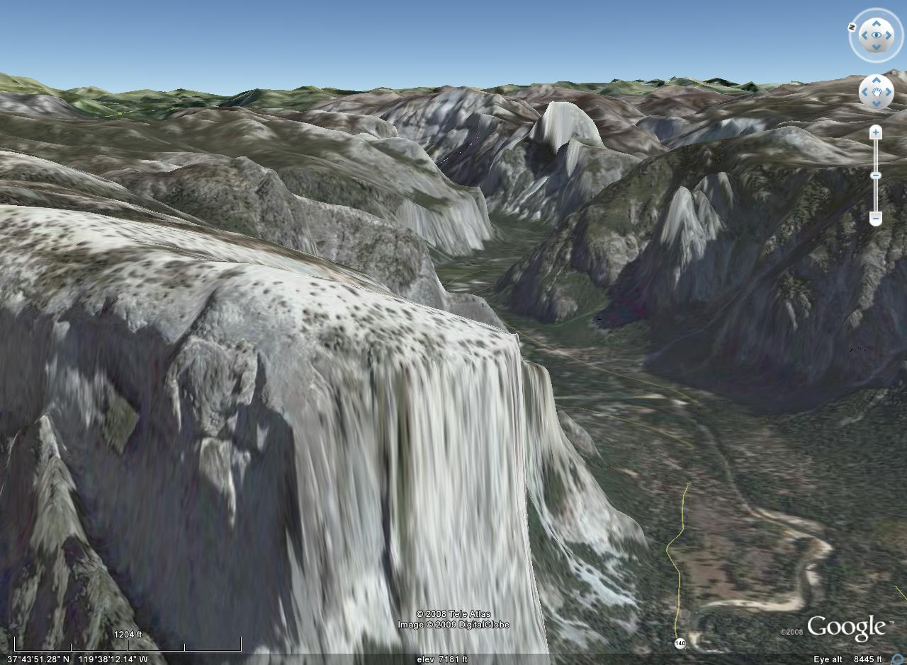
Half Dome
El Capitan
Notes:
If we superimpose the geologic map onto Yosemite’s topography in Google Earth …

Slide 19
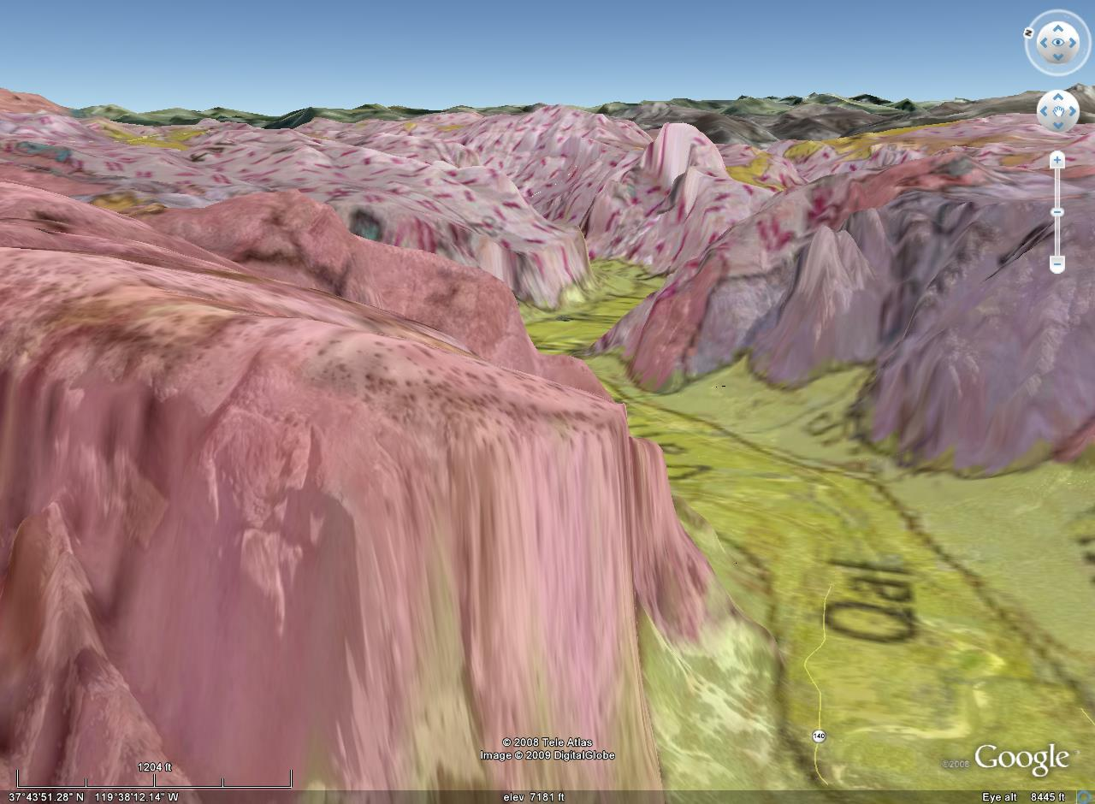
Tuolumne Intrusive Suite
Western Intrusive Suite
Notes:
… we can see the pink, dashed-pattern of the Tuolumne Intrusive Suite covering the eastern part of the park in the background, while the Western Intrusive Suite (solid colors) covers the foreground.

Slide 20
Notes:
The contact between the two intrusive suites is complex and includes syn-batholithic roof pendants as well as a spectrum of various plutonic rocks genetically related to the emplacement of the Tuolumne Intrusive Suite.

Slide 21
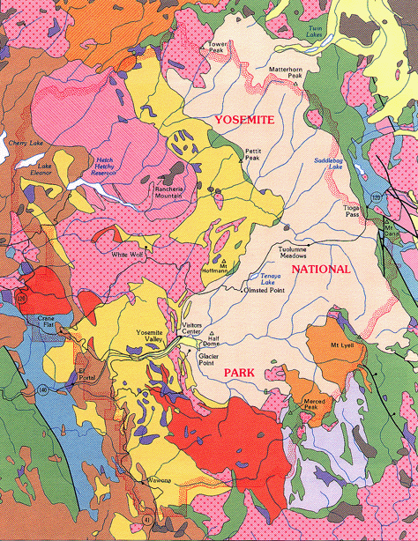
Tuolumne Intrusive Suite
Previous map area
Notes:
If we expand the previous map area several times we can see the vast Tuolumne Intrusive Suite in its entirety, covering almost the entire eastern portion of the park.

Slide 22
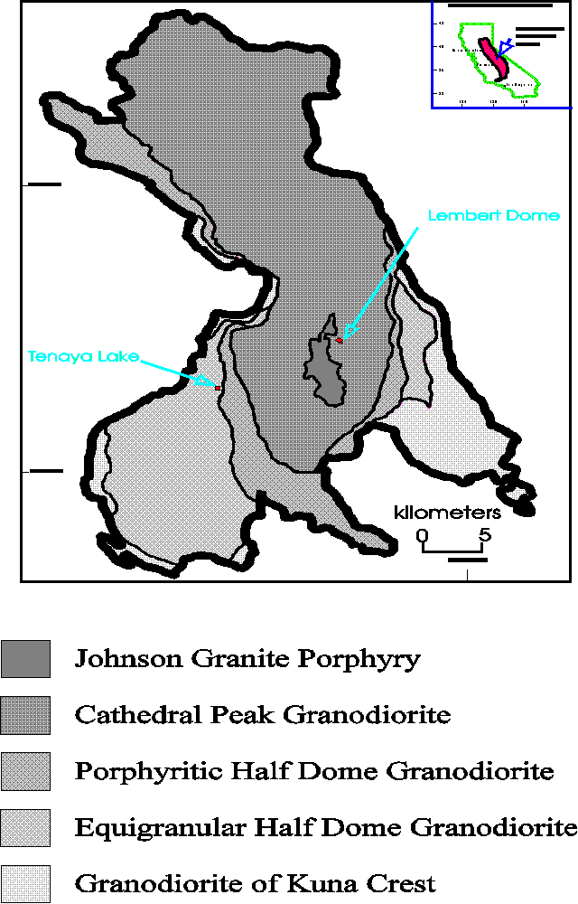
Notes:
Shaped something like a horse sitting on its rear, the Tuolumne Intrusive Suite is a world-class example of a “nested” pluton.

Slide 23
Nested Plutons
Nested Bowls
Notes:
Like nested bowls, the term implies that progressively smaller plutons are concentrically “stacked” inside larger plutons.

Slide 24
BATHOLITHIC ROCKS
210-150mya (Triassic to Jurassic)
120-100mya (Cretaceous)
Western Intrusive Suite (El Capitan Granite)
Minor Intrusive Suite (“Map of N. America”)
95-80mya (Cretaceous)
Tuolumne Intrusive Suite (Half Dome)
A “nested” pluton
Inside – felsic and porphyritic
Outside – mafic and equigranular
Notes:
As is typically the case for nested plutons, the Tuolumne Intrusive Suite is more mafic on the outside and felsic on the inside. Less common in nested plutons (but certainly not rare) are Tuolumne’s textural differences, which vary from equigranular on the outside, to commonly porphyritic textures on the inside.

Slide 25
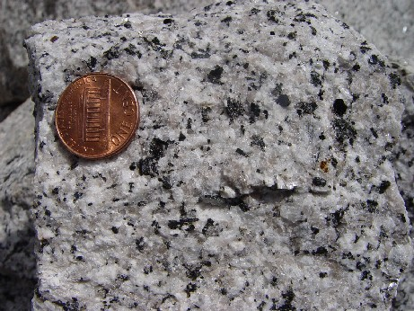
Half Dome Granodiorite
Notes:
We can see this pattern in the Half Dome Granodiorite. This piece is near the outside edge of the Tuolumne Intrusive Suite. Notice that all of its crystals are about the same size.

Slide 26
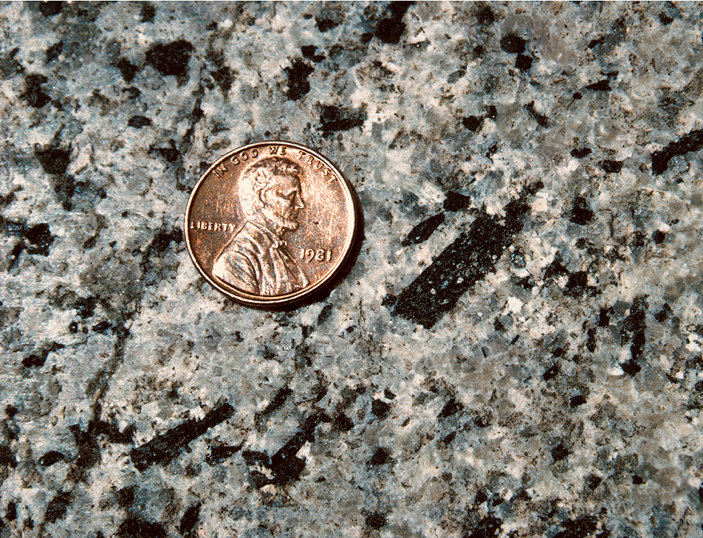
Half Dome Granodiorite
Notes:
In this specimen taken from further inside the suite, notice that some of the crystals are much larger than others and thus the texture is porphyritic.

Slide 27
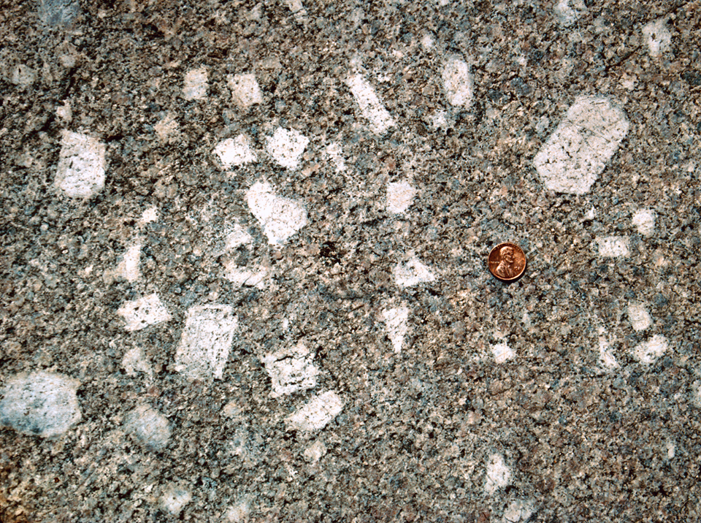
Cathedral Peak Granodiorite
Notes:
Towards the center of the suite the composition and texture is so much different than the edge, that a different formation name is given. The Cathedral Peak Granodiorite is blatantly porphyritic, with huge alkali feldspar crystals (phenocrysts).

Slide 28
Cathedral Peak Granodiorite
Two cooling rates.
Notes:
Porphyries always indicate two different cooling rates – very slow cooling for the large phenocrysts and more rapid cooling for the finer matrix crystals. As we will see, the models for producing nested plutons not only account for the silica variations seen, but also explain the formation of porphyritic textures.

Slide 29
brittle
rigidity
ductile
Notes:
One model works something like this: Since the lower part of the crust is ductile …

Slide 30
brittle
rigidity
55% SiO₂
ductile
Notes:
… plutons, driven by their relative buoyancy, will rise from subduction zones and work their way into the pliable lower crust ...

Slide 31
brittle
less
rigidity
density
55% SiO₂
ductile
more
Notes:
… until they encounter crust equal to their own density.

Slide 32
brittle
less
fast
low
fractionation potential
rigidity
density
cooling rate
60% SiO₂
50% SiO₂
ductile
more
slow
high
Notes:
Since this takes place near the bottom of the crust, the cooling rate is very slow, which gives ample time for fractionation of the magma to occur. Like an ice cube freezing, cooling progresses inward such that at some point the outside of the pluton will be solidified while the inside is still magma. Because low silica (mafic) minerals are the first to crystallize from a cooling silicate magma (remember Bowen’s Reaction Series?), the solidified margin of the pluton will be lower in silica than the interior. The magma has now separated, (fractionated) into different components based on silica content. Any crystals growing in the magma at this time will be relatively large because the cooling rate is so slow.

Slide 33
brittle
less
fast
low
60% SiO₂
fractionation potential
rigidity
density
cooling rate
50% SiO₂
ductile
more
slow
high
Notes:
Because magma density decreases as silica increases, the residual, silica-rich magma will be buoyed upwards until again it encounters crust equal to its own density.

Slide 34
brittle
less
fast
low
60% SiO₂
fractionation potential
rigidity
density
cooling rate
55% SiO₂
65% SiO₂
ductile
more
slow
high
Notes:
As this magma cools, the faster cooling rate near the surface causes the upper portion of the magma to solidify without fractionation while the lower portion continues to undergo fractionation, producing further silica enrichment in the residual magma.

Slide 35
brittle
less
fast
low
fractionation potential
rigidity
density
65% SiO₂
cooling rate
ductile
more
slow
high
Notes:
The buoyancy of that silica-enriched magma will cause it to rise as a second pulse of magma forced into the center of the first pulse.

Slide 36
porphyritic texture
brittle
less
fast
low
fractionation potential
rigidity
density
65% SiO₂
cooling rate
ductile
more
slow
high
Notes:
When this second batch of magma crystallizes, not only will it have more silica than the first batch, but it is likely to be porphyritic as well. That’s because it began crystallizing at depth where cooling is slow and large crystals form, but it competed crystallization nearer to the surface, where cooling is faster and smaller crystals form.

Slide 37
brittle
less
fast
low
fractionation potential
rigidity
density
cooling rate
ductile
more
slow
high
55% SiO₂
Notes:
An alternate model for nested plutons relies on deferent degrees of partial melting to achieve the silica variations, but again could produce the porphyritic textures through crystallization at different depths. Here, a pluton gets stuck at the base of the continental crust …

Slide 38
brittle
less
fast
low
fractionation potential
rigidity
density
cooling rate
60% SiO₂
Partial melting
ductile
more
slow
high
Notes:
… where it generates a more silica-rich magma by partially melting the base of the continental crust. Silica enrichment buoys the partial melt further upward into the continental crust while the original pluton and residual solids from partial melting become part of the lower crust and upper mantle.

Slide 39
brittle
less
fast
low
fractionation potential
rigidity
density
cooling rate
ductile
more
slow
high
55% SiO₂
small pluton
Notes:
If a smaller pluton gets trapped at the base of the crust, …

Slide 40
brittle
less
fast
low
fractionation potential
rigidity
density
cooling rate
65% SiO₂
ductile
more
slow
high
Small amount of partial melting
Notes:
… only a small portion of the crust will melt, which will be only the very most silica-rich minerals. Thus this partial melt will be smaller in volume but greater in silica concentration.

Slide 41
brittle
less
fast
low
fractionation potential
rigidity
density
cooling rate
ductile
more
slow
high
Notes:
Again a nested pluton is produced with a more silica-rich center, but this model may not produce as distinctly porphyritic rocks as the first.

Slide 42
Development of the Tuolumne Intrusive Suite
Notes:
The development of the Tuolumne Intrusive Suite probably involved one or both of these mechanisms. Detailed field study of the suite indicates that the first pulse of magma solidified to produce the relatively mafic-rich granodiorite of Kuna Crest. Before this magma had completely solidified …

Slide 43
Notes:
… a surge of fresh magma locally breached the Kuna Crest and solidified as the equigranular phase of the Half Dome Granodiorite. Before this magma completely solidified …

Slide 44
Notes:
… a new pulse of magma intruded and formed the porphyritic phase of the Half Dome Granodiorite.

Slide 45
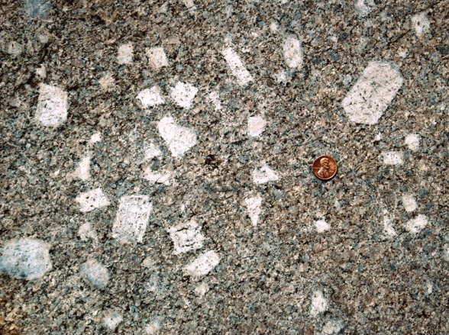
Notes:
The third surge of magma was followed by the solidification of the Cathedral Peak Granodiorite and emplacement of the Johnson Granite Porphyry.

Slide 46
Think you know it all?
Notes:
Well if your head hasn’t exploded with all those magma surges, you might think you have a pretty good understanding of magmatic processes now.

Slide 47
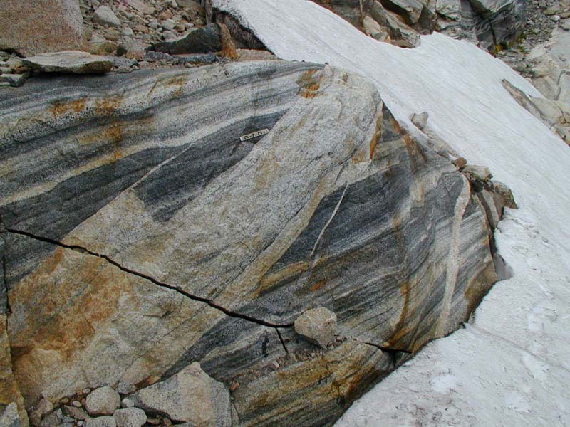
Notes:
Well think again!

Slide 48
Notes:
The Tuolumne Intrusive Suite is notorious for boggling geologists with fiendish textures and bizarre structural relationships.

Slide 49
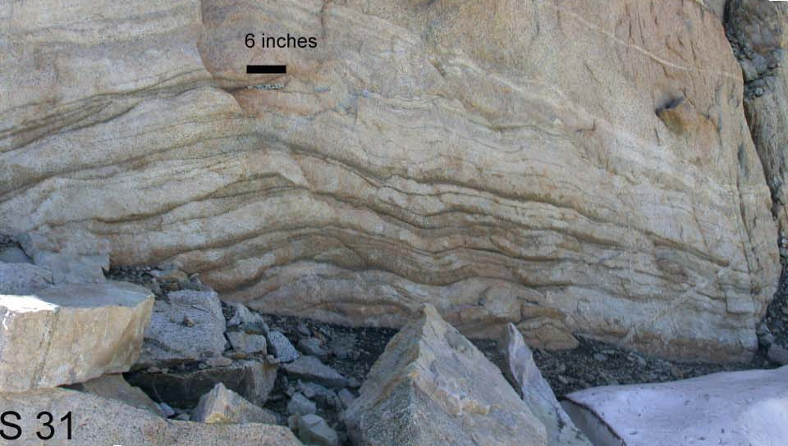
Notes:
There are places where these plutonic rocks take on down-right sedimentary textures.

Slide 50
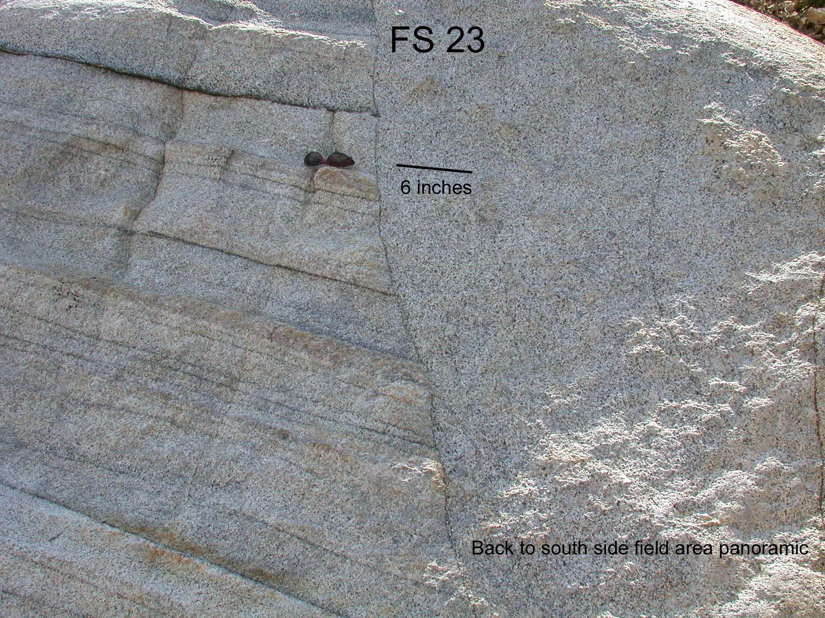
Notes:
Yet layers can be abruptly juxtaposed against perfectly ordinary crystalline textures.

Slide 51
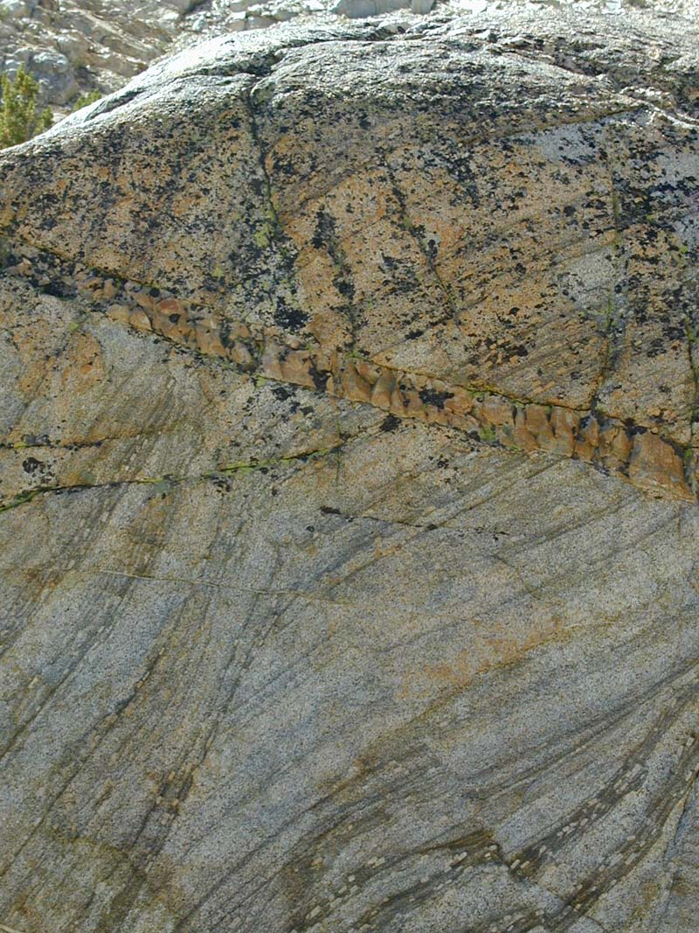
Notes:
I’ll not explain these …

Slide 52
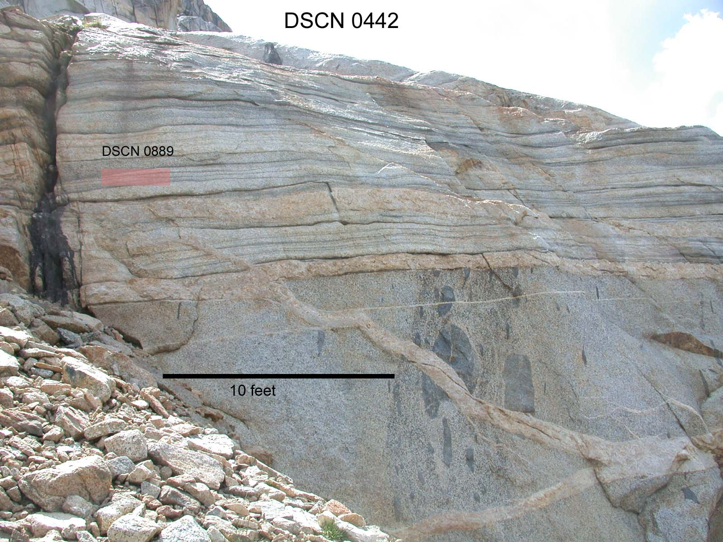
Notes:
… because I can’t!

Slide 53
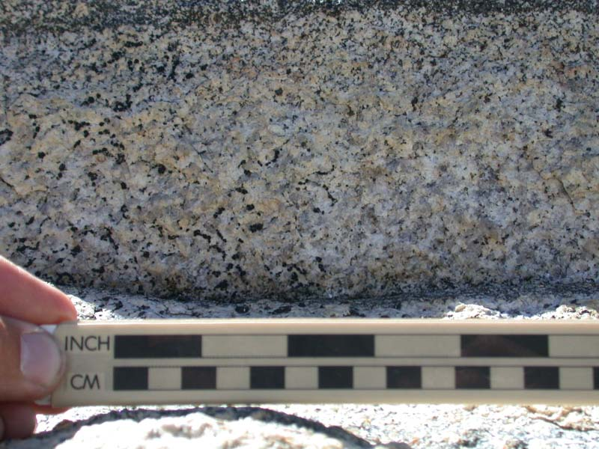
Notes:
There even are textures that resemble turbidites!

Slide 54
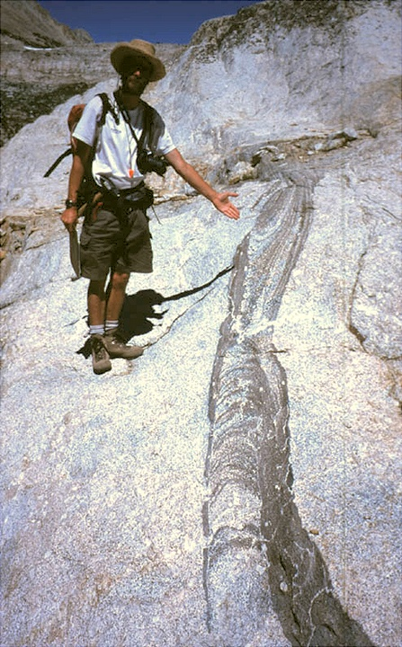
Notes:
But my favorites are the magma worms!

